Slide 1
Files and Streams
Pradeep rao T

Slide 2
There are two kinds of streams: byte streams and character streams (a.ka. binary streams and text streams,respectively).
An input stream is an object that an application can use to read a sequence of data, and an output stream is an object that an application can use to write a sequence of data
Byte Streams
Java byte streams are used to perform input and output of 8-bit bytes. Though there are many classes related to byte streams but the most frequently used classes are , FileInputStream and FileOutputStream.
Character Streams
Java Byte streams are used to perform input and output of 8-bit bytes, where as Java Character streams are used to perform input and output for 16-bit unicode.
Though there are many classes related to character streams but the most frequently used classes are , FileReader and FileWriter.. Though internally FileReader uses FileInputStream and FileWriter uses FileOutputStream but here major difference is that FileReader reads two bytes at a time and FileWriter writes two bytes at a time

Slide 3
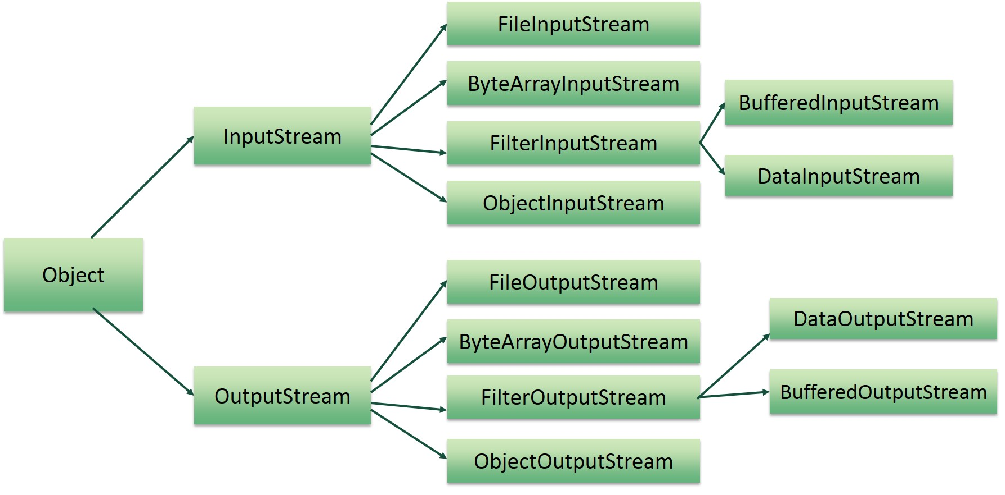
Hierarchy of classes to deal with Input and Output streams.

Slide 4
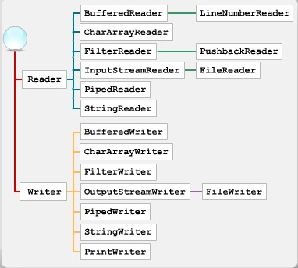
Hierarchy of classes to deal with Reader and Writer.

